Slide 1
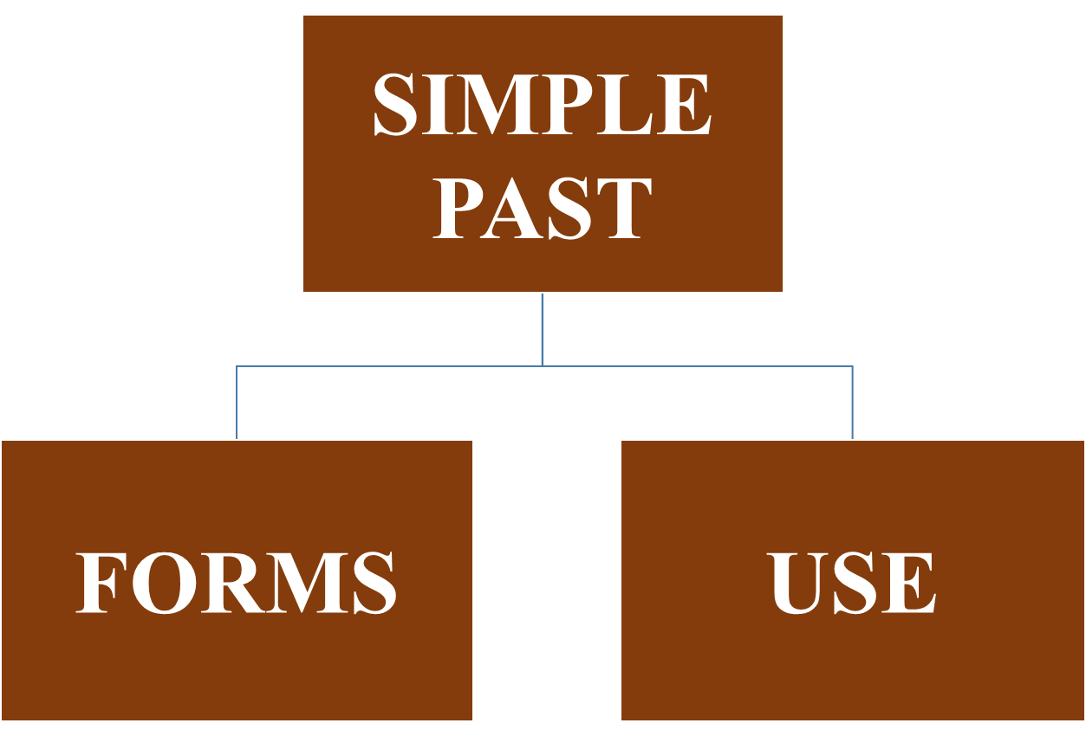

Slide 2
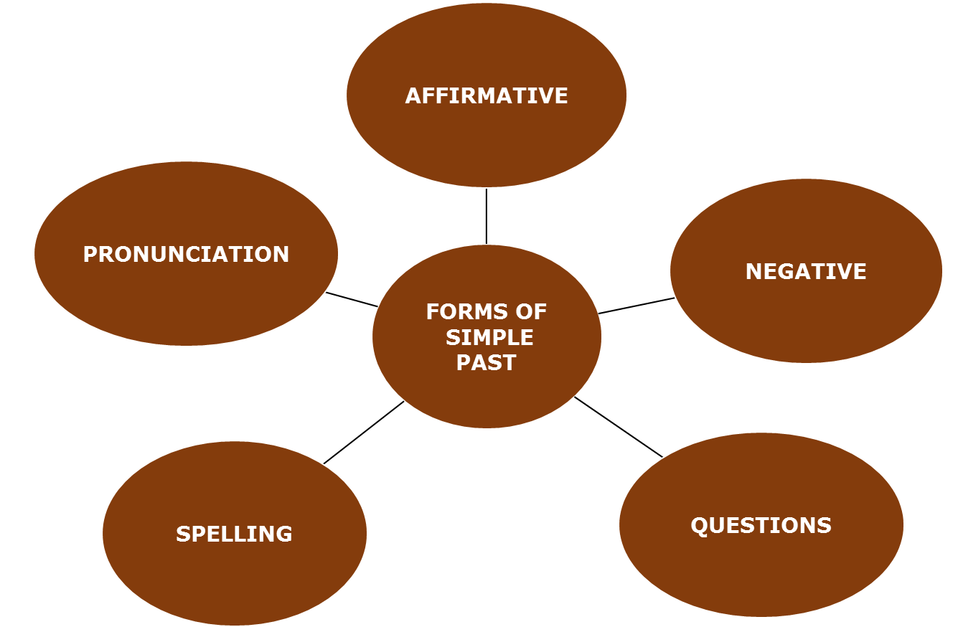

Slide 3
Simple past form (Affirmative)
This form is also called ‘past simple’.
Subject + Verb (past) + Complement
He went to London
They went to London

Slide 4
Simple past form
Simple past form (Affirmative)
Regular verbs
I worked
you worked
he/she/it worked
we worked
they worked
Irregular verb
I went
you went
he/she/it went
we went
they went

Slide 5
Simple past form
Simple past form (Negative)
Subject + didn’t (did not) +infinitive+ complement
He didn’t go to London
They didn’t go to London

Slide 6
Simple past form (Negative)
Regular verbs
I did not work
you did not work
he/she/it did not work
we did not work
they did not work
Irregular verbs
I did not go
you did not go
he/she/it did not go
we did not go
they did not go

Slide 7
Simple past form (Contraction)
Contraction | Pronunciation | Meaning
didn’t | /didnt/ | did not

Slide 8
Simple past form (Questions)
We make simple past questions with
Did +Subject + Verb (base) + Complement + ?
Did he go to London ?
Did they go to London ?

Slide 9
Simple past form (Questions)
Regular verbs
did I work?
did you work?
did he/she/it work?
did we work?
did they work?
Irregular verbs
did I go?
did you go?
did he/she/it go?
did we go?
did they go?

Slide 10
Exercise
Make simple past questions.
Regular verbs
1. He cleaned the car.
Did he clean the car?
(Not Did he cleaned the car?)
Irregular verbs
2. The class went to Rome.(where)
Where did the class go?
(Not Where did the class went?)

Slide 11
Exercise
3. John enjoyed the food.
Did John enjoy the food?
4. She listened to everything.
Did she listen to everything?
Circle the correct form.
1. I take/took my father to Spain last week.
I took my father to Spain last week.
2. Did you hear/heard me?
Did you hear me?

Slide 12
Exercise
Be careful when questions have long subjects -the word order does not change.
Where did Ann stay?
Where did Ann and her mother stay?
Where did Ann, her mother and the children stay?
Make simple past questions.
1. Tom and his wife went to Moscow. (where)
Where did Tom and his wife go?
2. Mrs Potter’s two boys played football yesterday. (when)
When did Mrs Potter’s two boys play football?

Slide 13
Exercise
When who and what are subjects, we make questions without did.
Compare:
‘Who phoned? ’ ’Sue phoned.’
(Not’ Who did phone?’)
‘Who did you see? ’’I saw Sue.’
‘What happened?’ ’Something nice happened.’
(Not ‘What did happen?’)
‘What did he say?’ ’He said something nice.’

Slide 14
Exercise
Make simple past questions with what, who and where.
1. Peter saw somebody. (who)
Who did he see?
2. John went somewhere. (where)
Where did John go?
3. Bill bought something. (what)
What did Bill buy?

Slide 15
Exercise
Circle the correct form.
Who gave/ did give you that ring?
Who gave you that ring?
2. What wanted John?/did John want?
What did John want?
Complete the questions.
1.’Somebody heard me.’ ‘Who…………..’
‘Who heard me.’
2.’I heard somebody.’ ‘Who……………….’
‘Who did I (you) hear?’

Slide 16
Spelling of regular affirmative past simple forms
1.Most regular verbs: add –ed
work: worked
stay: stayed
show: showed
wonder: wondered
visit: visited
rain: rained

Slide 17
Spelling of regular affirmative past simple forms
2.When the simple form of a verb ends in e, only d is added.
hope: hoped
decide: decided
change: changed
dance: danced
like: liked

Slide 18
Spelling of regular affirmative past simple forms
3. When a one–syllable verb ends in a single consonant (excepting w or y) precede by a single vowel ,the final consonants is doubled and ed is added.
shop: shopped
stop: stopped
plan: planned

Slide 19
Spelling of regular affirmative past simple forms
4.When a verb of more than one syllable ends in a single consonant preceded by a single vowel, the final consonant is doubled when the final syllable is stressed.
omit: omitted
occur: occurred
refer: referred
regret: regretted

Slide 20
Spelling of regular affirmative past simple forms
But if the last syllable is not stressed
don’t double
offer: offered
visit: visited
listen: listened
wonder: wondered

Slide 21
Spelling of regular affirmative past simple forms
5.Verbs ending in consonant+y: change y to i and add –ed
hurry: hurried
Cry: cried
study: studied
try: tried
reply: replied
But (vowel+ y):
play: played
enjoy: enjoyed

Slide 22
Spelling of regular affirmative past simple forms
Two vowels before constant: don’t double
seem: seemed
wait: waited
two consonants at the end:don’t double
want: wanted
help: helped
Verbs ending in-c have ck in the past.
picnic: picnicked
Panic: panicked
In British English,-L is doubled in the past after one short vowel even if the vowel is not stressed:
travel: travelled.

Slide 23
Pronunciation of –ed
The regular past ending –ed is pronounced as follows:
1./d/ after vowel and constant
tried /traId/; lived /lIvd/; used /ju:zd/; failed /faIld/
2./t/ after unvoiced consonants
stopped /stopt/; passed /pa:st/; laughed /la:ft/; watched /wotst/; worked /w3:kt/
3./Id/ after /d/ and /t/
ended /endId/; started /sta:tId/

Slide 24
SIMPLE PAST
USE

Slide 25
Simple past use
We often use the simple past to talk about when things happened.
I left school in 1990.
I didn’t see Ann yesterday.
What time did you arrive?
We use the simple past, not the
present perfect with finished time-expressions.
I saw that film last week.
How about drama?

Slide 26
Simple past use
Note the word order with ago.
Ago follows an expression of time.
An expression with ago refers to a finished time, and is normally used with a past tense, not a present perfect.
I started this job three years ago.
(Not…ago three years.)
It happened a long time ago.

Slide 27
Exercise
Complete the sentences. Put the verb into the correct form, positive or negative.
1.It was warm, so I…………..off my coat. (take)
took
2.It was hard carrying the bags. They…..very heavy. (be)
were
3.The film was very good. I……..it very much. (enjoy)
enjoyed

Slide 28
Exercise(negative)
4.I was in a hurry, so I………time to phone you. (have)
didn’t have
5.I knew Sarah was very busy, so I………her. (disturb)
didn’t disturb
6.The hotel wasn’t very expensive. It…………...very much. (cost)
didn’t cost

Slide 29
Exercise
7.I was very tired, so I………..the party early. (leave)
left
8.The window was open and a bird……..into the room. (fly)
flew
9.The bed was very comfortable. I……very well. (sleep)
slept

